Slide 1
Show & Tell
Slide Editor
By:
Caleb Rush, Nicholas Totolos, Matt Downey
Notes:
#FF5722
#009688

Slide 2
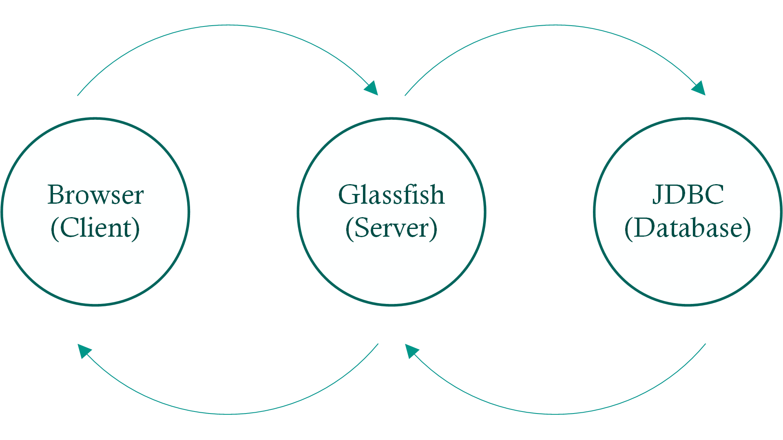
Design
RESTful
MVC
Glassfish
JSP
JDBC

Slide 3
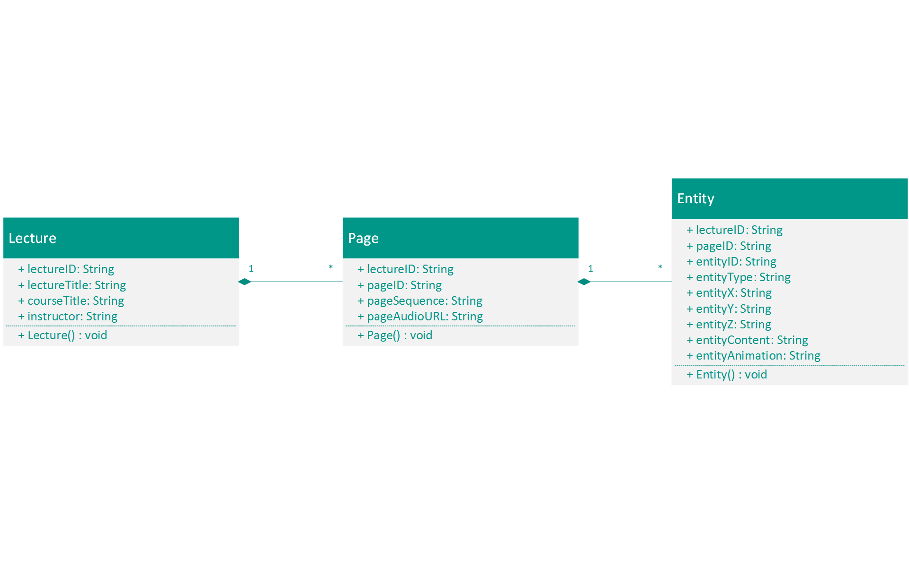
Model Design

Slide 4
Client/Server Programming Paradigm - Issues
Client/Server programming is very different
Easy to write bad code
Disorienting

Slide 5
Client/Server Programming Paradigm - Resolution
Each group member worked on a different perspective
Every group member could think clearly in their own context
Forced us to agree upon a common interface
Allowed us to divide the responsibilities logically and rationally

Slide 6
Client/Server Programming Paradigm - Resolution
Document/Comment EVERYTHING
Made sure we understood everything we wrote
Explain our reasoning for other team members, and even future selves
Helped us understand each other's code in case it needed fixed

Slide 7
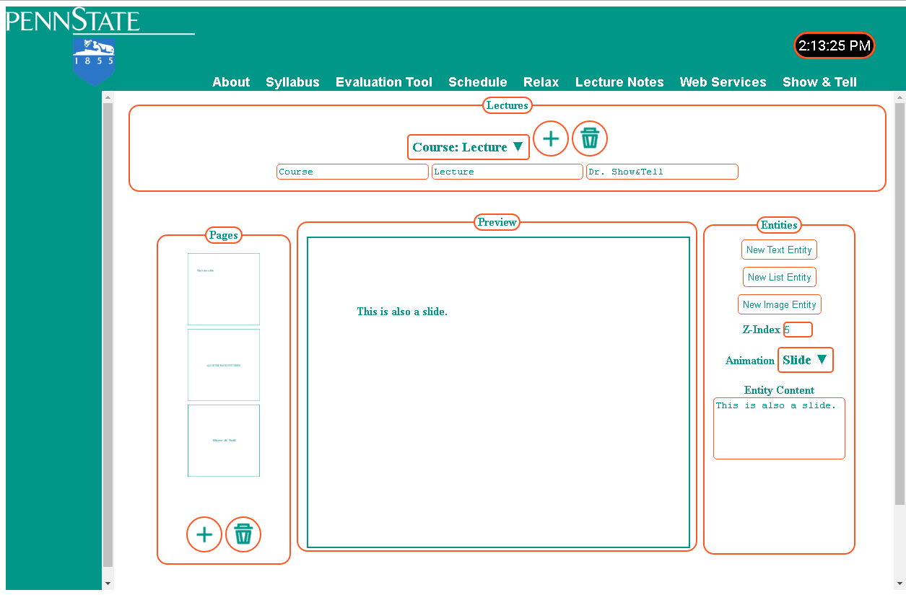

Slide 8
Moving and Resizing Entities
Create an HTML element to represent each entity
Use jQueryUI features to make the elements draggable and resizeable
Subscribe event listeners to elements to update entities

Slide 9
Saving Images to the Database
Images are uploaded client side
Images are encoded to Base64 data URLs
Data URLs are sent to the server
Data URLs are decoded back into binary image data
Image is saved to file on server
Path to image is saved to database
When image is loaded back later, we can just use the path

Slide 10
Taking Snapshots of Pages
Use a library called “html2canvas” to convert preview element to canvas
Use canvas features to retrieve a data URL for the page’s image data
Send data URL to server
Decode and save data as image like before

Slide 11
Lessons Learned - Nick
GitHub
SQL
JavaScript
JavaBeans
CSS is not for the weak minded

Slide 12
Lessons Learned - Caleb
Collaboration is difficult, but extremely important
CSS makes children cry

Slide 13
Lessons Learned - Matt
Documentation Vs Implementation of Web-Tech
Test everything for yourself, don’t always assume it will work
Not all documentation is equal, some sources are much more helpful than others
Common Practice Vs Best Practice
CSS makes me cry

